Slide 1

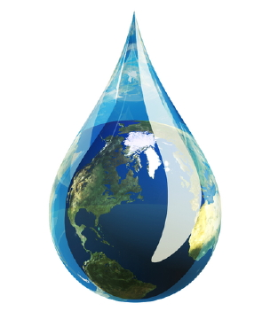
W
WORLD
A
T
E
Situation
Challenges &
Opportunities
R

Slide 2
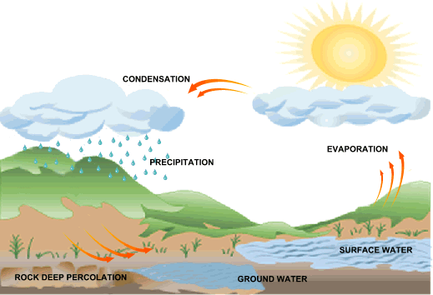
Before starting,
water resources at a glance:
Freshwater resources:
Easy to access
High turnover
Easy to pollute
Surface water
Harder to access
Low turnover
Harder to pollute
Groundwater
Recycling /
Desalination
High technology
High cost
High energy
Simplified water cycle

Slide 3
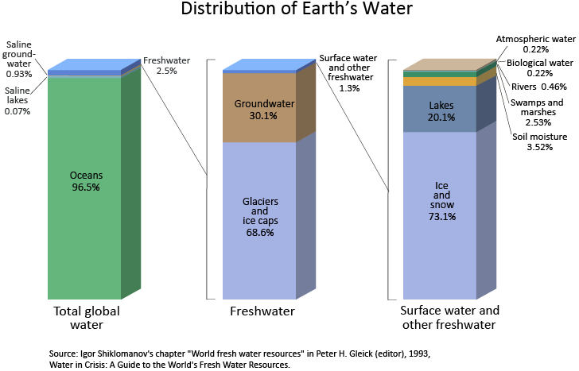
Fresh water are 2.5% of the world water budget.
Accessible fresh water are 0.75% of the world water budget.

Slide 4
Some math:
World total renewable fresh water is 47,000 (km³/y).
World population is ~7 billion.
Availability ~ 18,400 liters/person/day
Water consumption in North America (which is world highest) is 6800 (liters/person/day).
Hurray - Enough water for all.

Slide 5
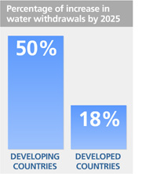
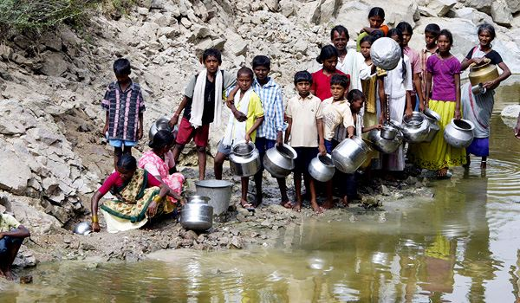
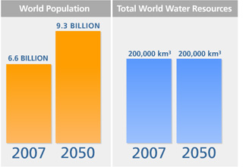
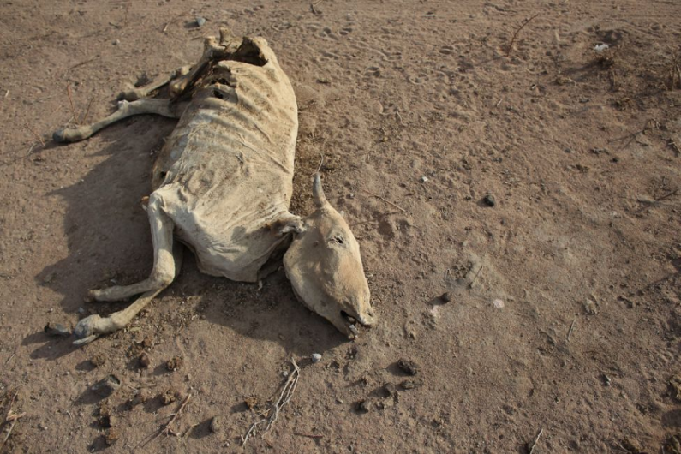
So how come that:
One of six people worldwide don’t have access to safe freshwater
Every 20 seconds a child dies as result of poor sanitation
(150 kids during this talk)
Between 1991-2000 over 665,000 people died in natural disasters, of which 90% were water related events.

Slide 6
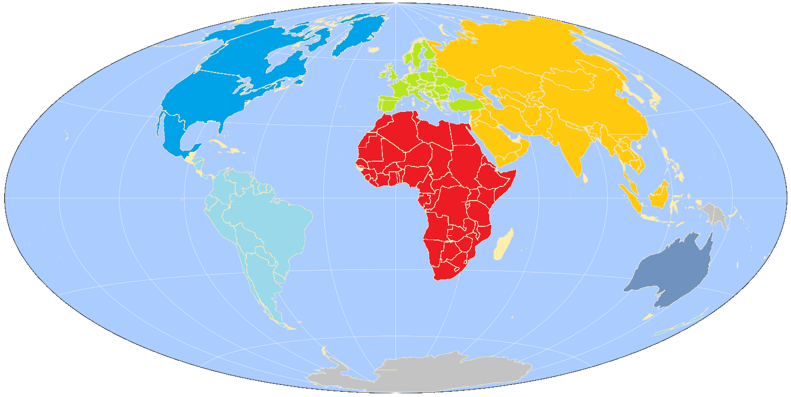

World population and water resources are not evenly distributed
8% 13%
15% 8%
36% 60%
11% 13%
26% 6%
5% 1%

Slide 7


Add to that:
+
Politics
+
Technology
Education &
Economic limitations
=
Water quality problems

Slide 8
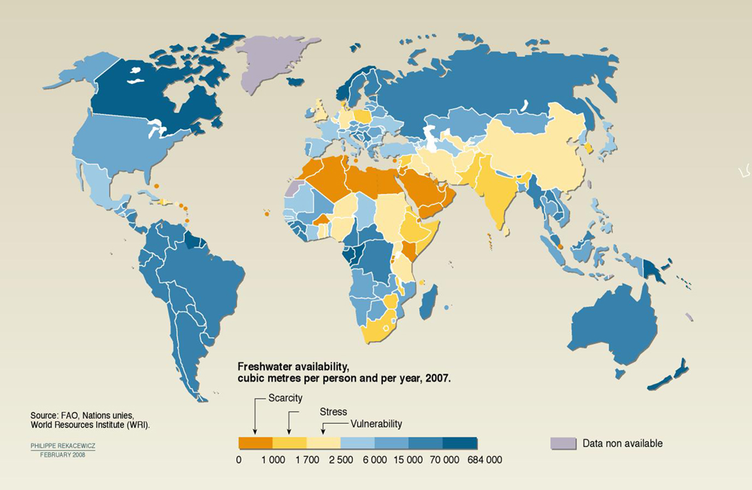
World freshwater availability:
We will focus on 5 case studies, examining their water challenge's and solutions

Slide 9
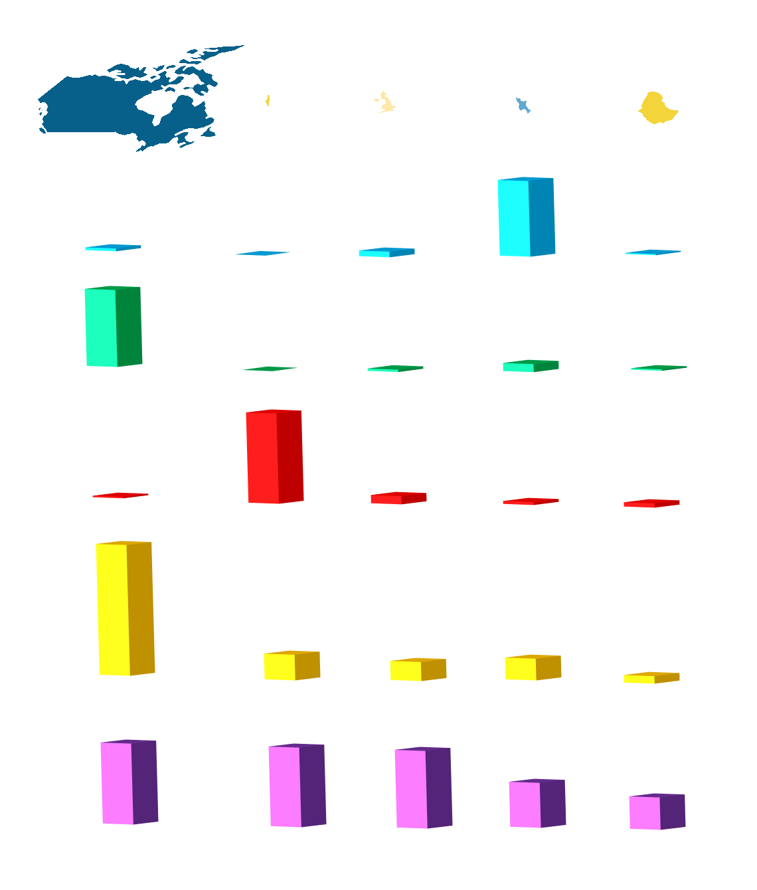
Canada Israel UK Bangladesh Ethiopia
9984670
22070 243610 144000 1104300
Area (km²)
&
population
Available water per
square km/year (m)
Available water per
Capita/year (m³)
Use of available
water (%)
Water use per capita
Per year (m³)
HDI
33M 7M 62M 147M 81M
8.5
0.29 0.08 0.6 0.11
86177
245 2375 8345 1503
102
1.58 8.81 2.92 4.556
1470
282 212 244
80.5
0.908 0.888 0.863
0.5
0.363

Slide 10
Canada Israel UK Bangladesh Ethiopia
9984670
22070 243610 144000 1104300
Area (km²)
&
population
Available water per
square km/year (m)
Available water per
Capita/year (m³)
Use of available
water (%)
Water use per capita
Per year (m³)
HDI
33M 7M 62M 147M 81M
8.5
0.29 0.08 0.6 0.11
86177
245 2375 8345 1503
102
1.58 8.81 2.92 4.556
1470
282 212 244
80.5
0.908 0.888 0.863
0.5
0.363

Slide 11
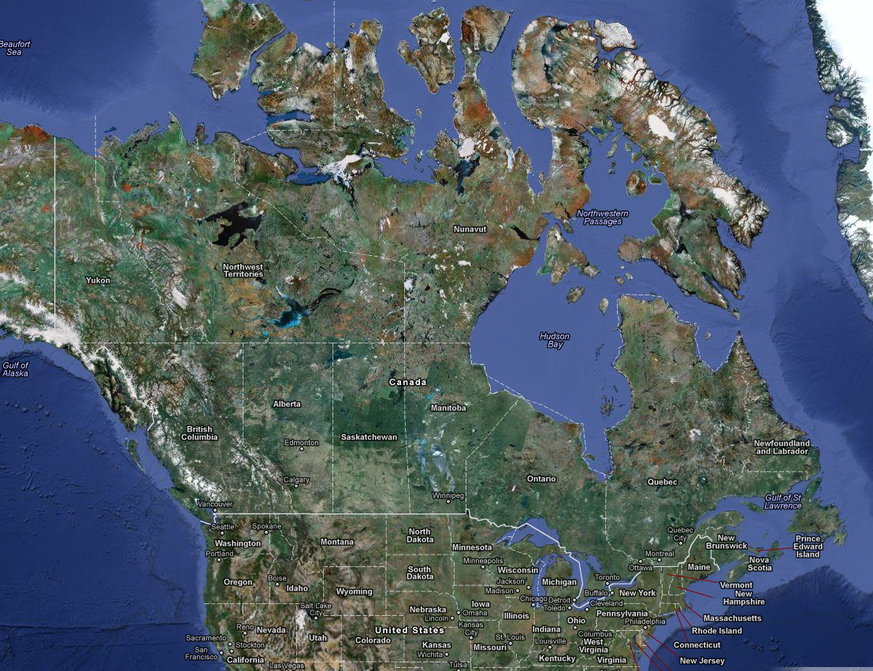
Canada:
~2000km
~5000km

Slide 12
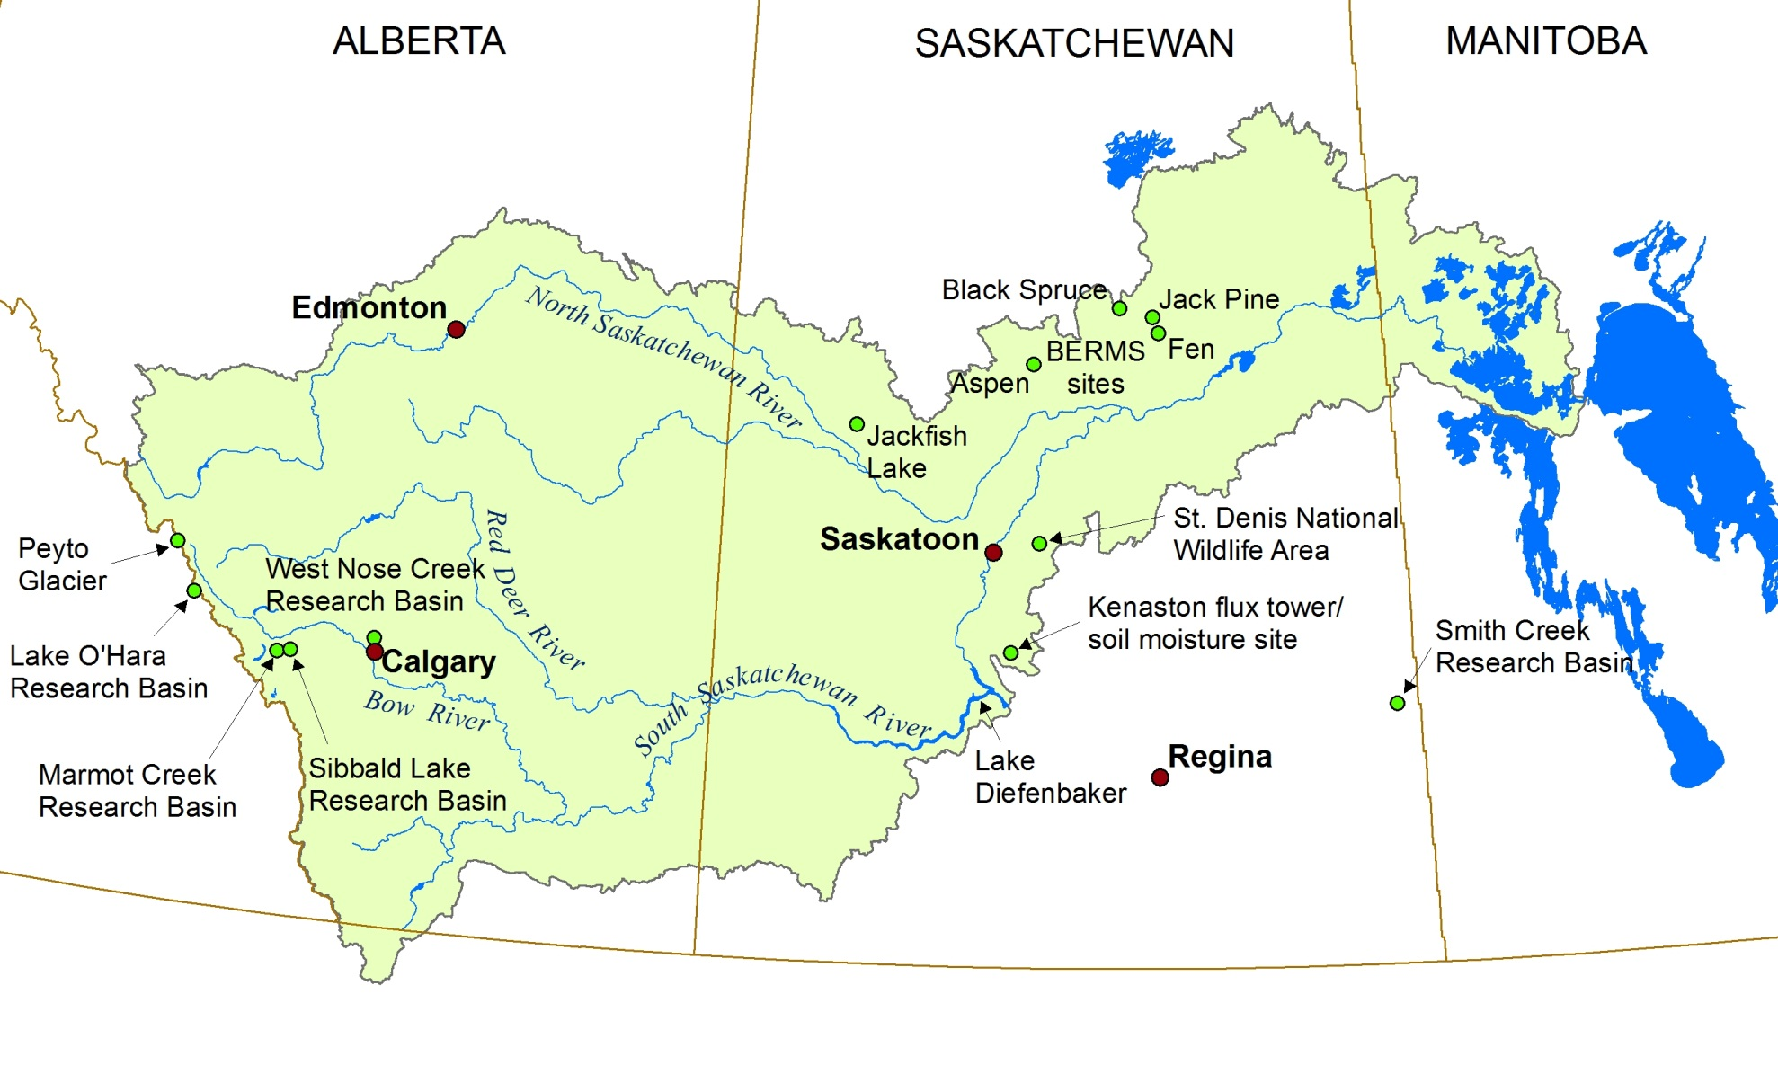
Saskatchewan River Basin

Slide 13
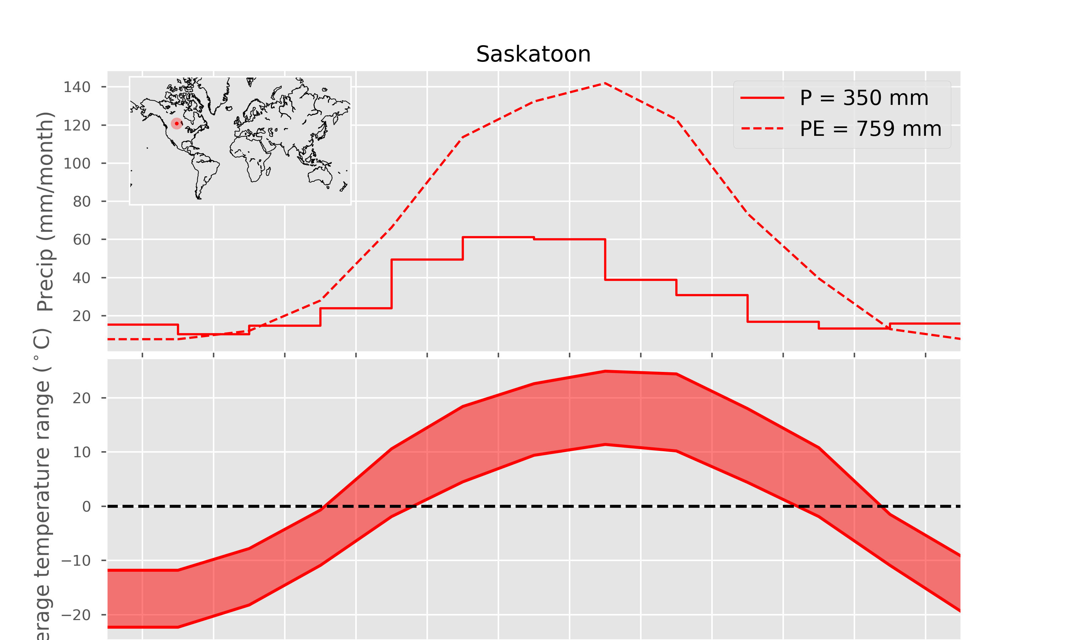

Slide 14
Prairie Drought of 1999-2004 Most Expensive Natural Disaster in Canadian History
Issues: Drought
$5.8 billion decline in GDP 2001-2002
$3.6 billion drop in agricultural production, 2001-2002
41,000 jobs lost
BC, Alberta forest fires
Saskatchewan dust storms

Slide 15
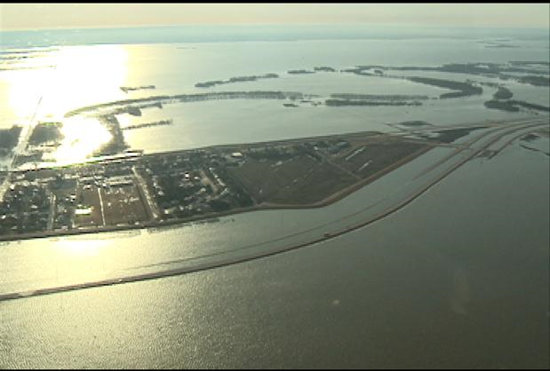
Issues: Floods
Farmland in southern Manitoba, along the Red River valley, is covered with water.
Photo Credit: Josh Arason, Global News

Slide 16
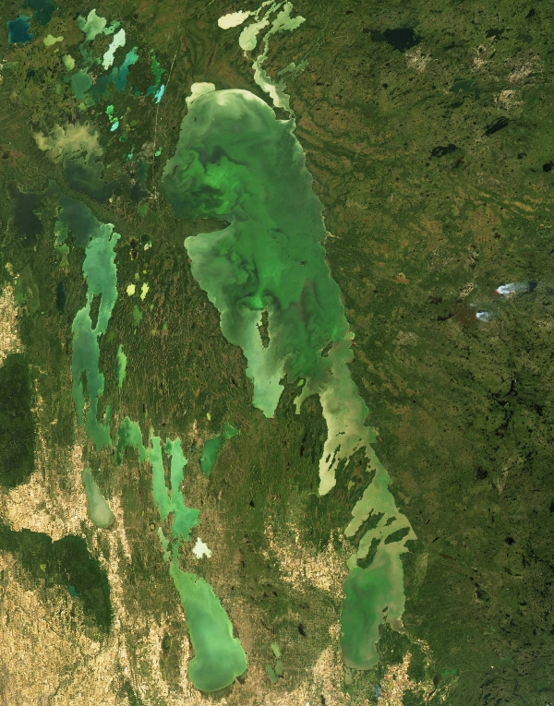
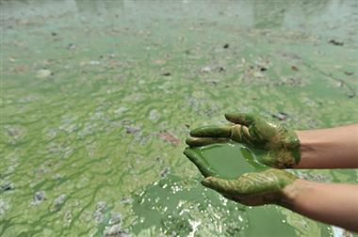
Issues: Water quality
Lake Winnipeg algal blooms
covered 15,000 km² in 2007
Photo: Reuters
http://www.canada.com/news/Feds+lack+know+deal+with+dirty+rivers+lakes+report/3802002/story.html
Image: Greenpeace Canada
http://www.greenpeace.org/canada/en/Blog/beyond-factory-farming-hog-farms-and-friendly/blog/3761

Slide 17
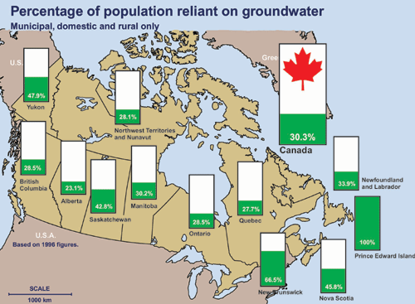
Issues: Groundwater

Slide 18
Canada Israel UK Bangladesh Ethiopia
9984670
22070 243610 144000 1104300
Area (km²)
&
population
Available water per
square km/year (m)
Available water per
Capita/year (m³)
Use of available
water (%)
Water use per capita
Per year (m³)
HDI
33M 7M 62M 147M 81M
8.5
0.29 0.08 0.6 0.11
86177
245 2375 8345 1503
102
1.58 8.81 2.92 4.556
1470
282 212 244
80.5
0.908 0.888 0.863
0.5
0.363

Slide 19
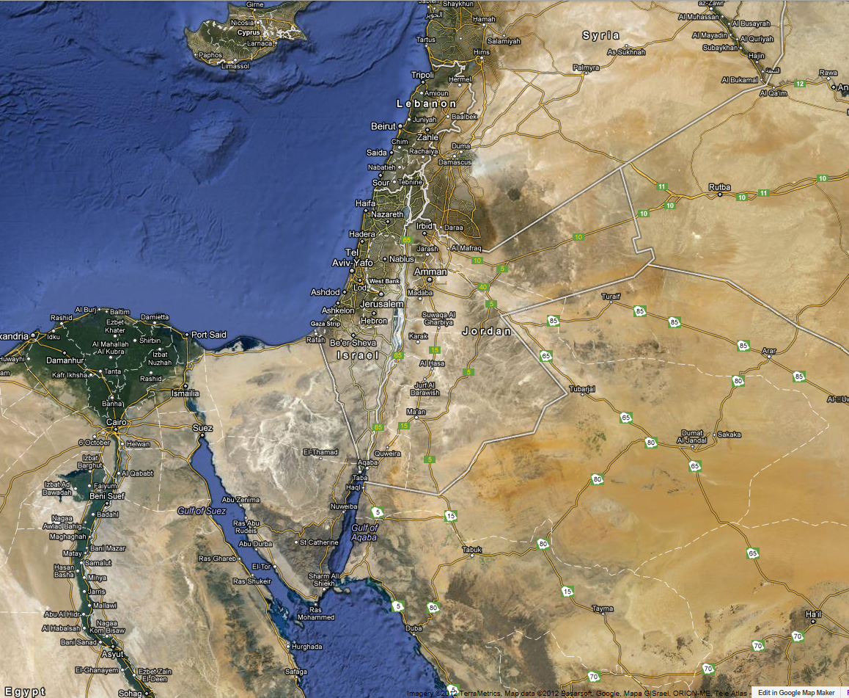
<500km
~100km

Slide 20
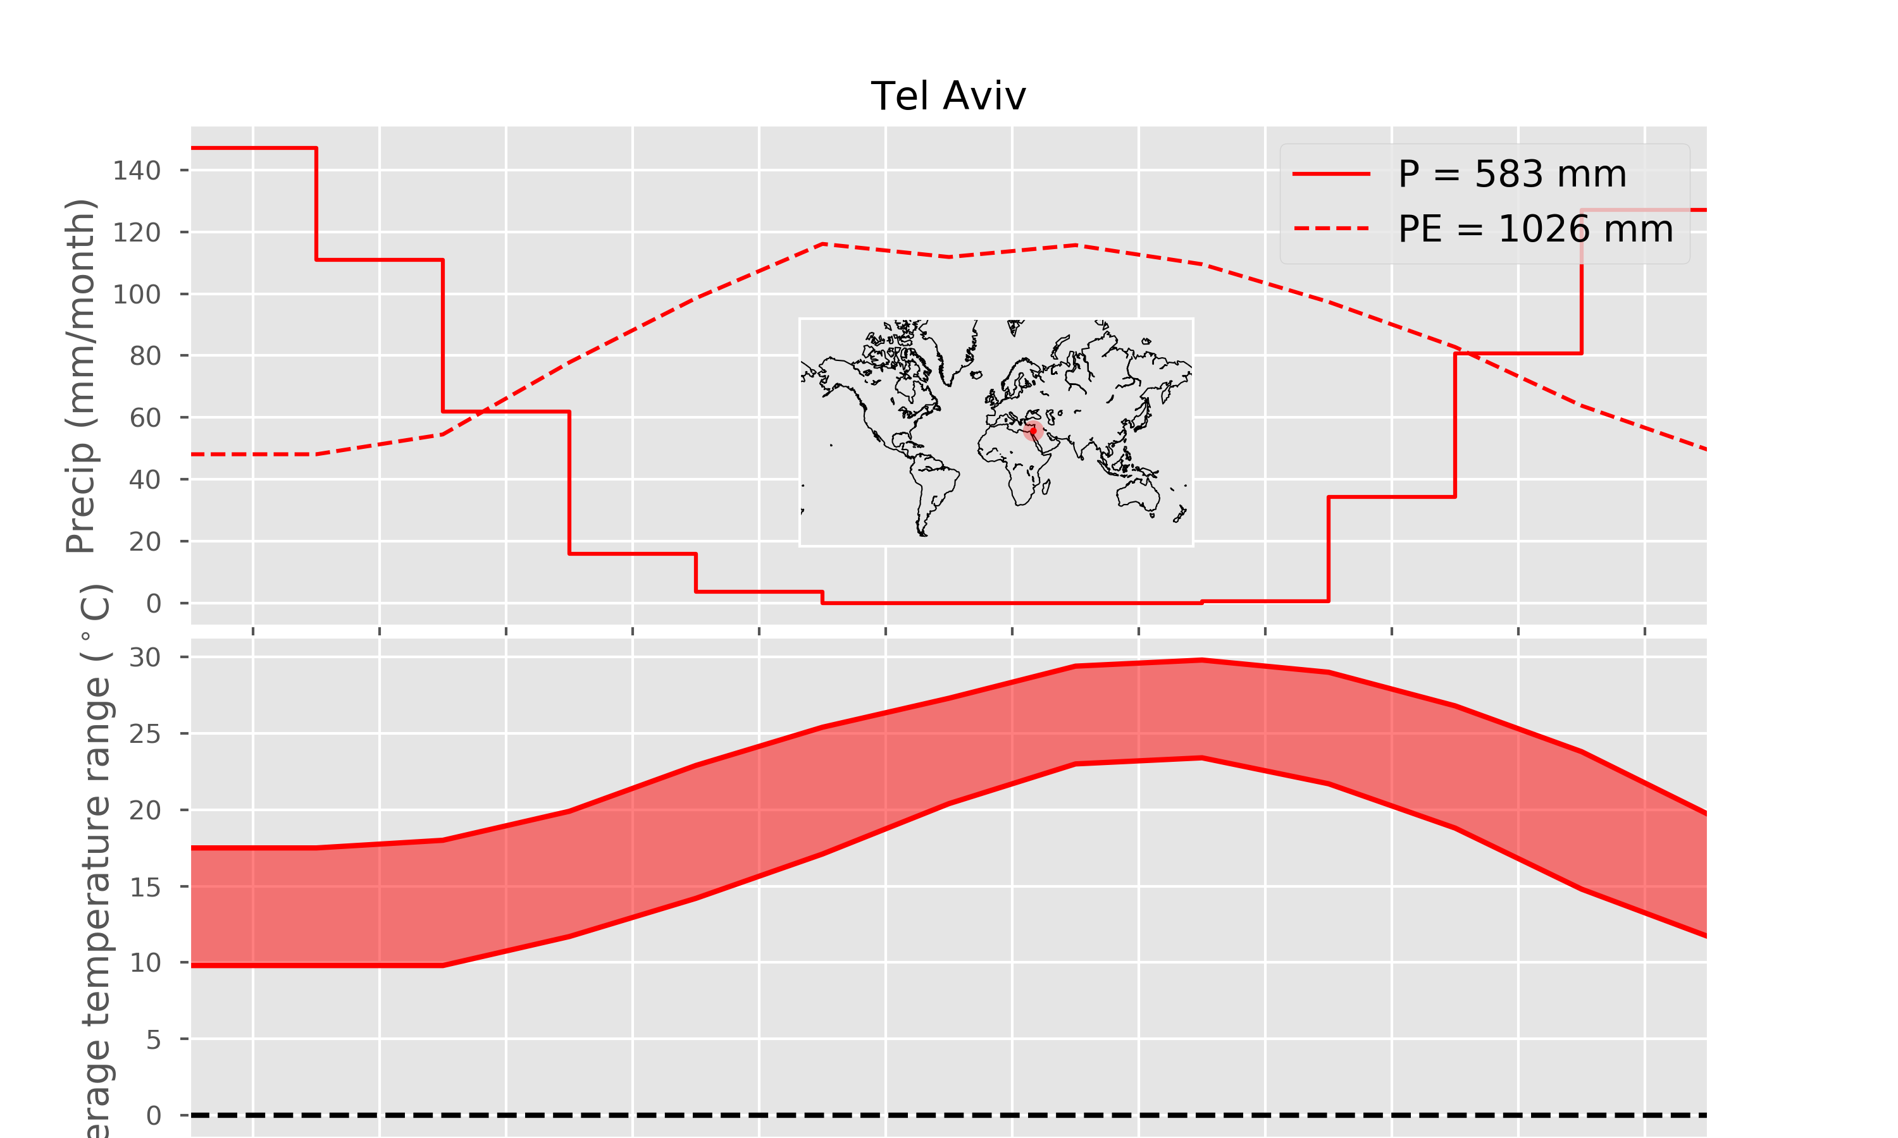

Slide 21
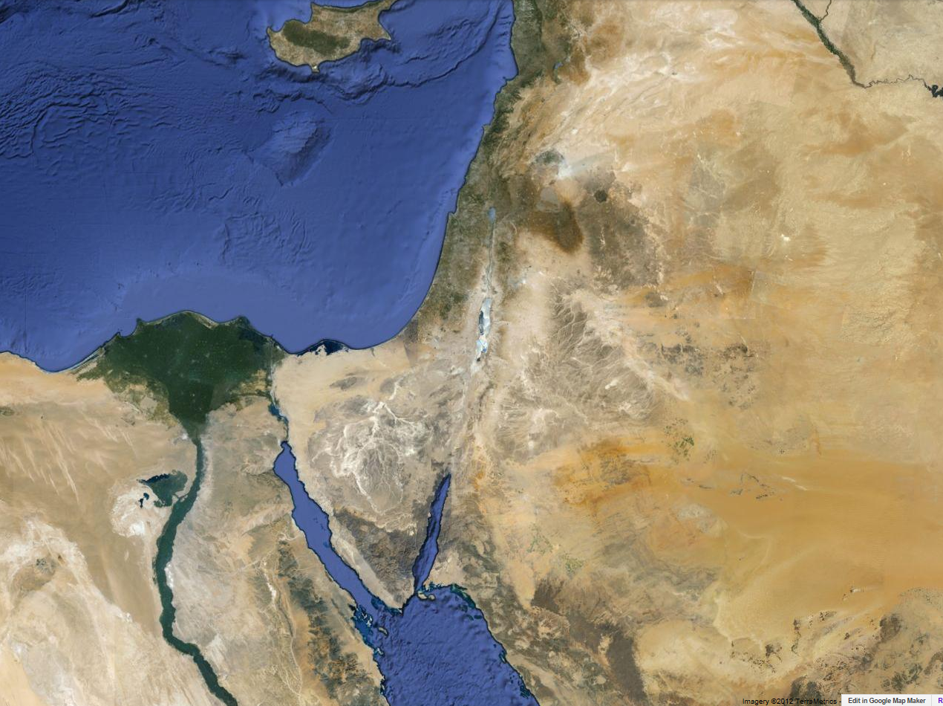
Lake Kineret:
26% of Israel water supply.
Costal & Mountain Aquifers:
44% of Israel water supply.
Challenges: Lack of water.
Population stress.
Massive agriculture.
Water distribution.

Slide 22
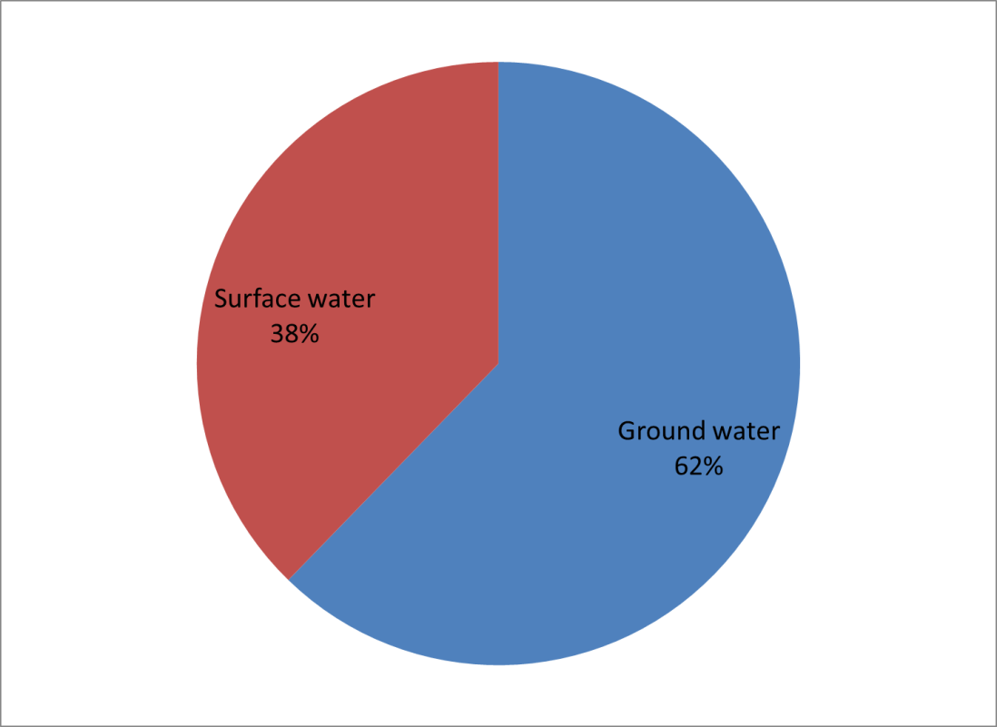
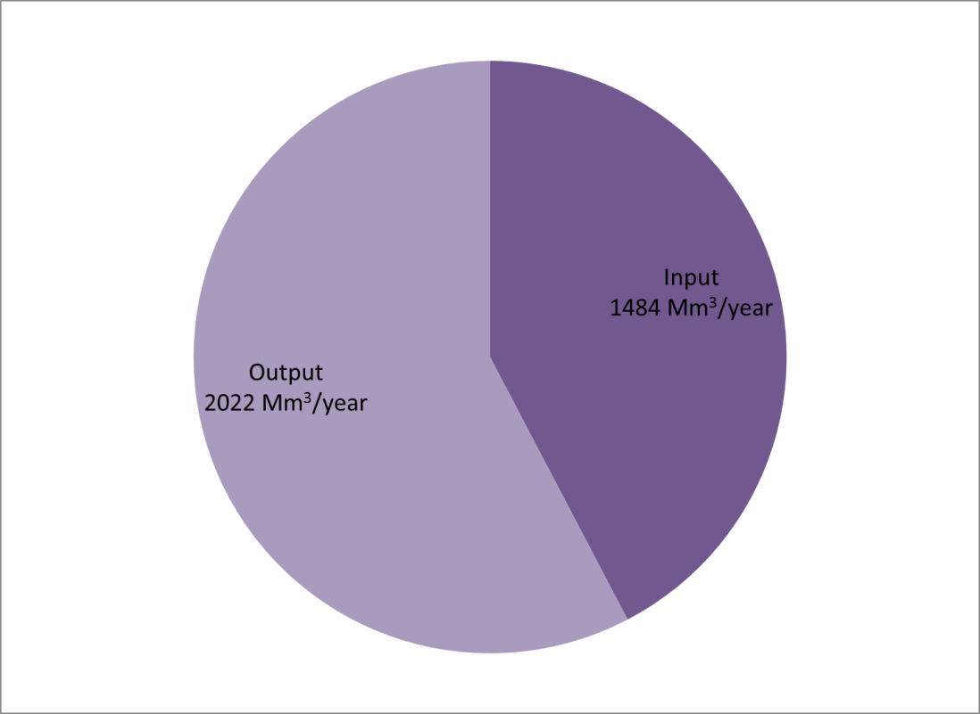
Israel natural water balance:
Problem!!!

Slide 23
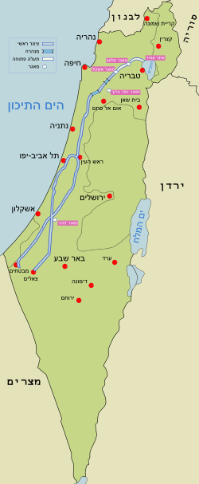
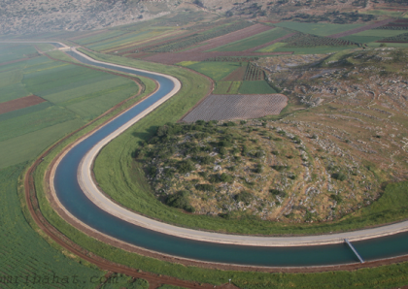
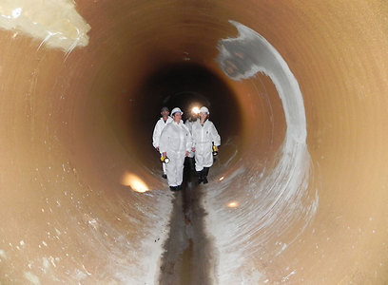
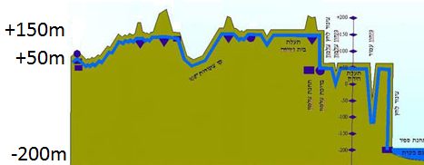
Solutions:
Water transfer - National water carrier
Max. flux: 450 Mm³/year
Energy : 4% of Israel consumption

Slide 24
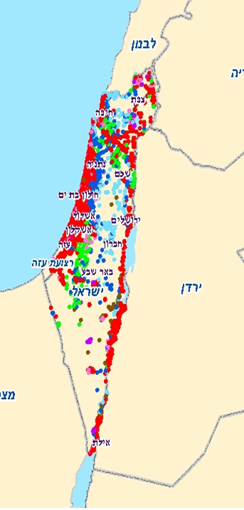
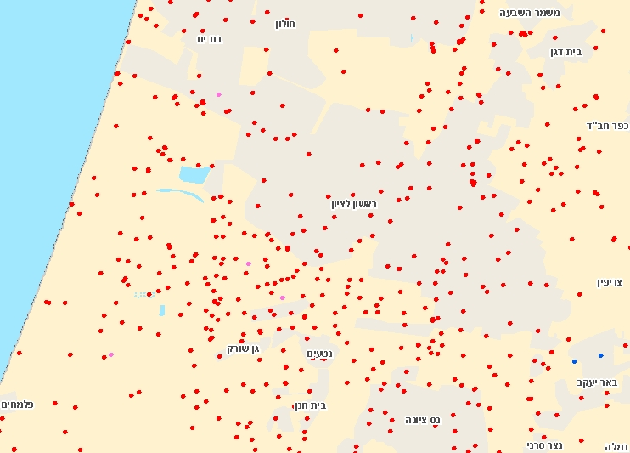
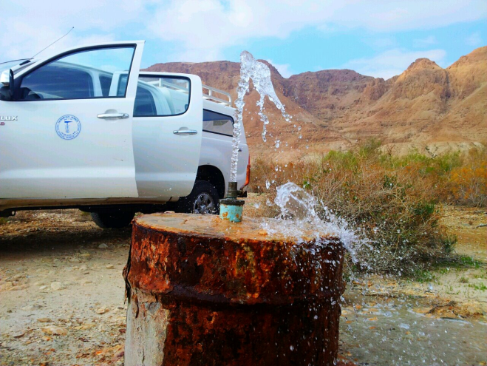
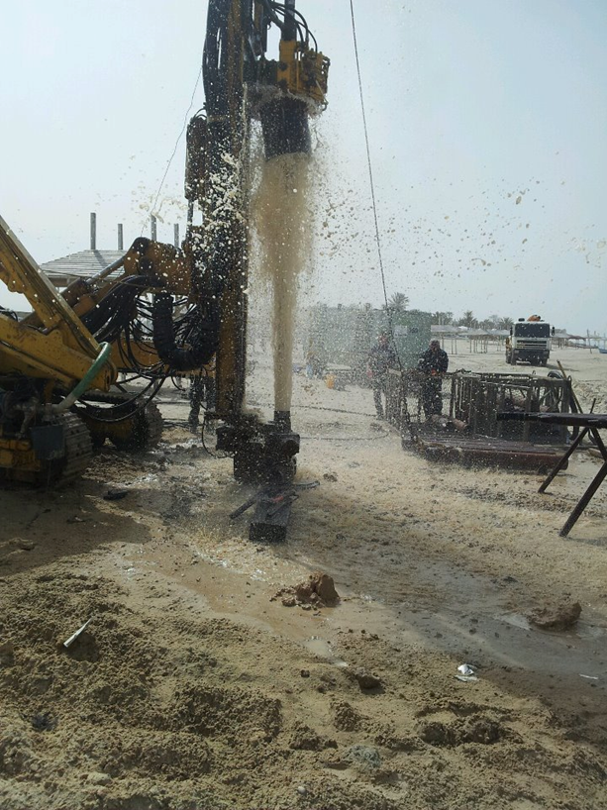
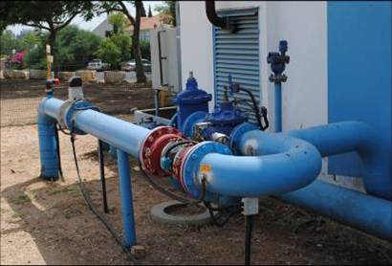
Solutions:
Wells in
Israel
Ground water use
Hundreds of wells all over Israel supply 924 Mm³/year.
5 km

Slide 25
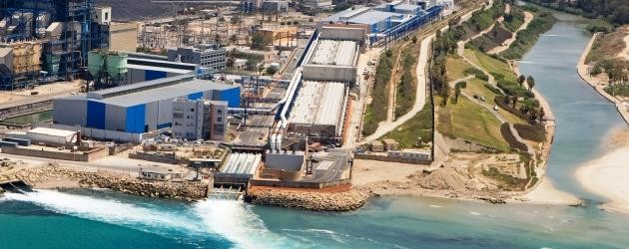
Solutions:
Desalination
By 2020 will supply 50% of domestic and industrial consumption.
High energy consumer.
cost of $0.6 for 1m³, while cost of unsupplied 1m³ is $2.
Contributes 300 Mm³/year.

Slide 26
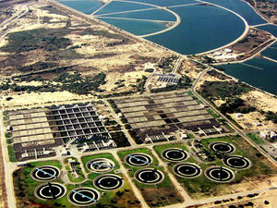
Solutions:
Sewage recycle
More than 75% of the sewage in Israel is being treated.
The treated sewage supply more than 30% of agricultural use.
Contributes 335 Mm³/year

Slide 27


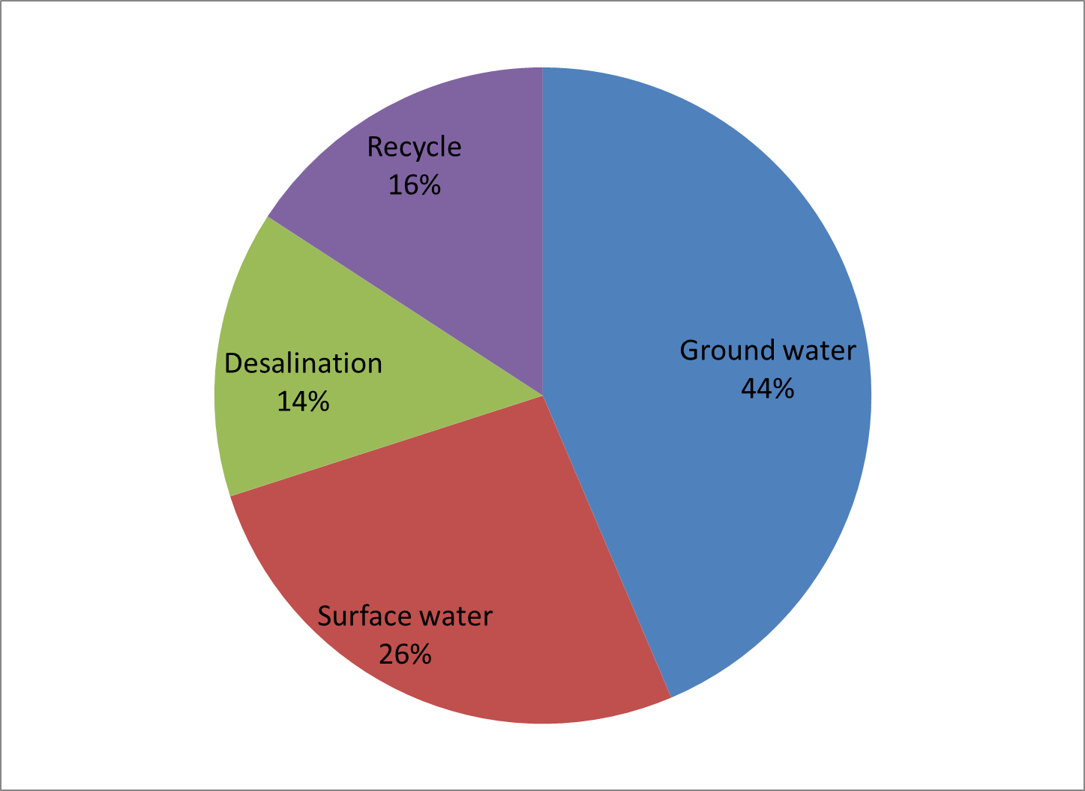
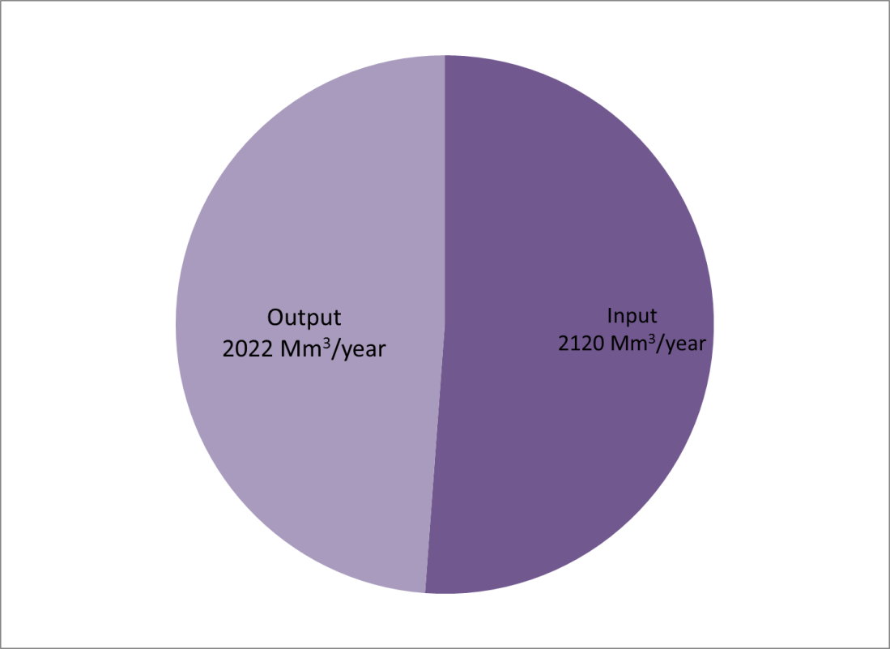
Israel water balance:

Slide 28
Canada Israel UK Bangladesh Ethiopia
9984670
22070 243610 144000 1104300
Area (km²)
&
population
Available water per
square km/year (m)
Available water per
Capita/year (m³)
Use of available
water (%)
Water use per capita
Per year (m³)
HDI
33M 7M 62M 147M 81M
8.5
0.29 0.08 0.6 0.11
86177
245 2375 8345 1503
102
1.58 8.81 2.92 4.556
1470
282 212 244
80.5
0.908 0.888 0.863
0.5
0.363

Slide 29
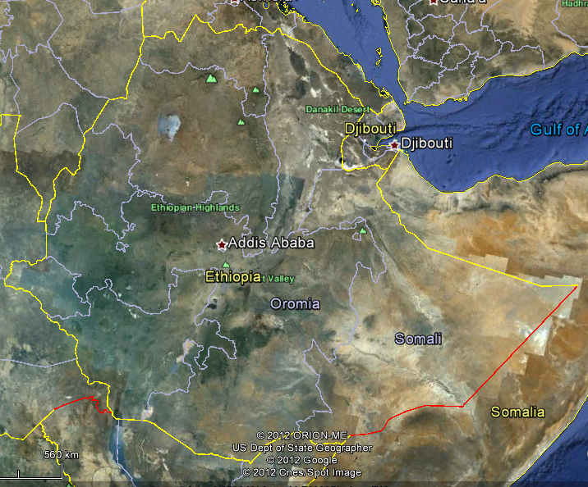
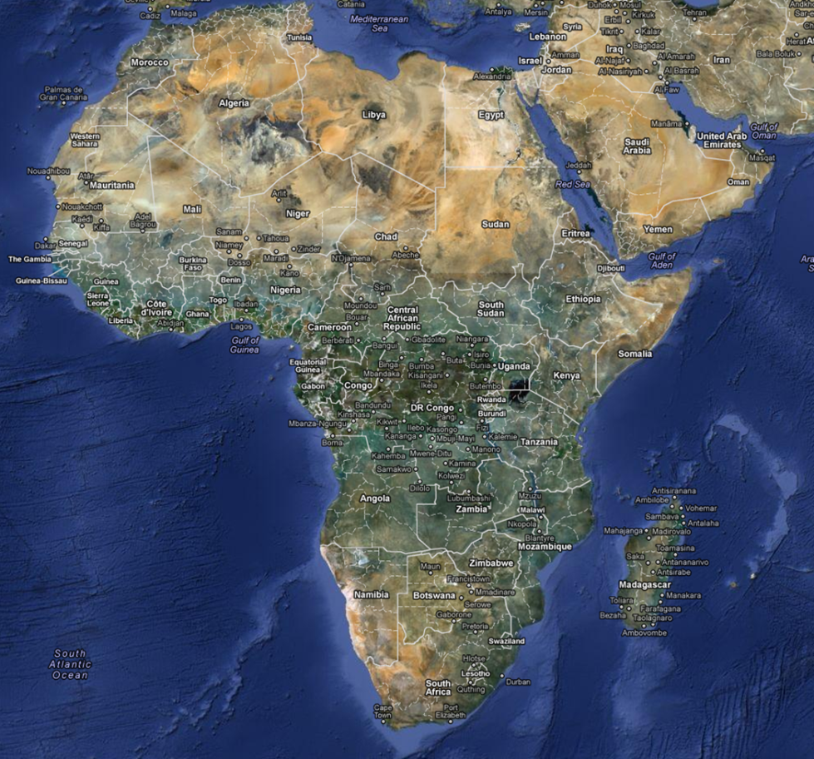


Ethiopia:
One example for local use of ground water
~1000km
~1600km
Challenges: Water accessibility.
Water quality.

Slide 30
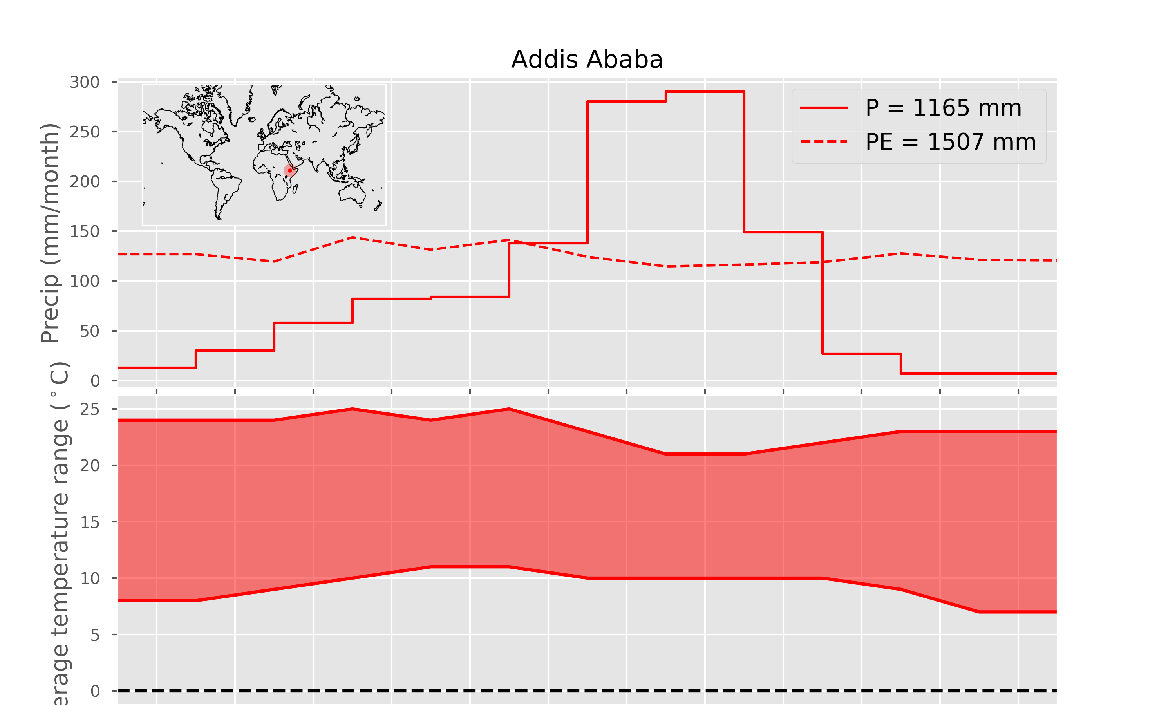

Slide 31
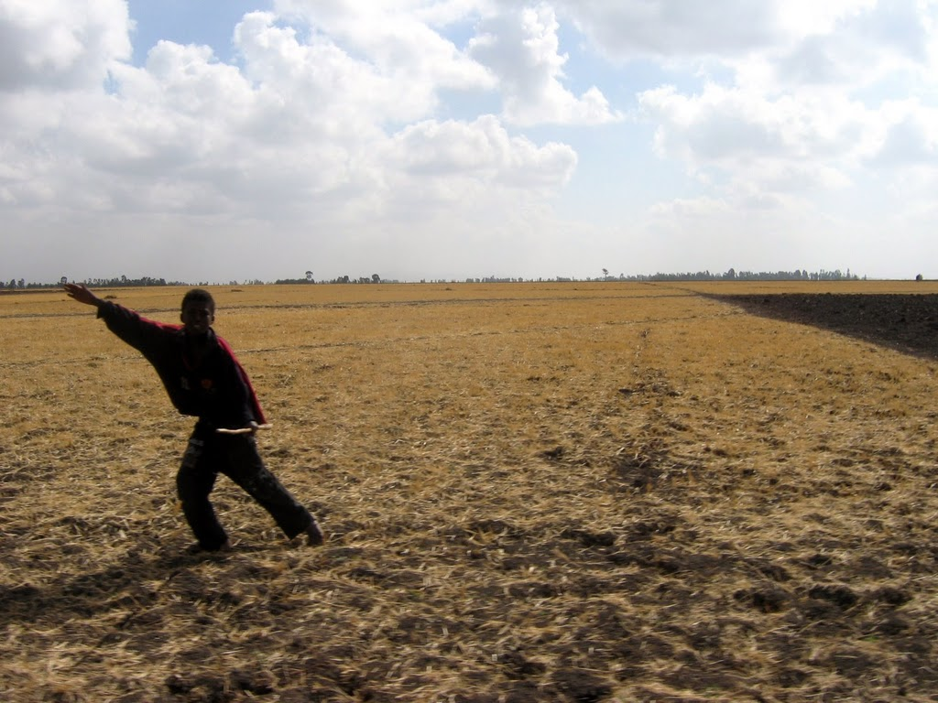

Slide 32
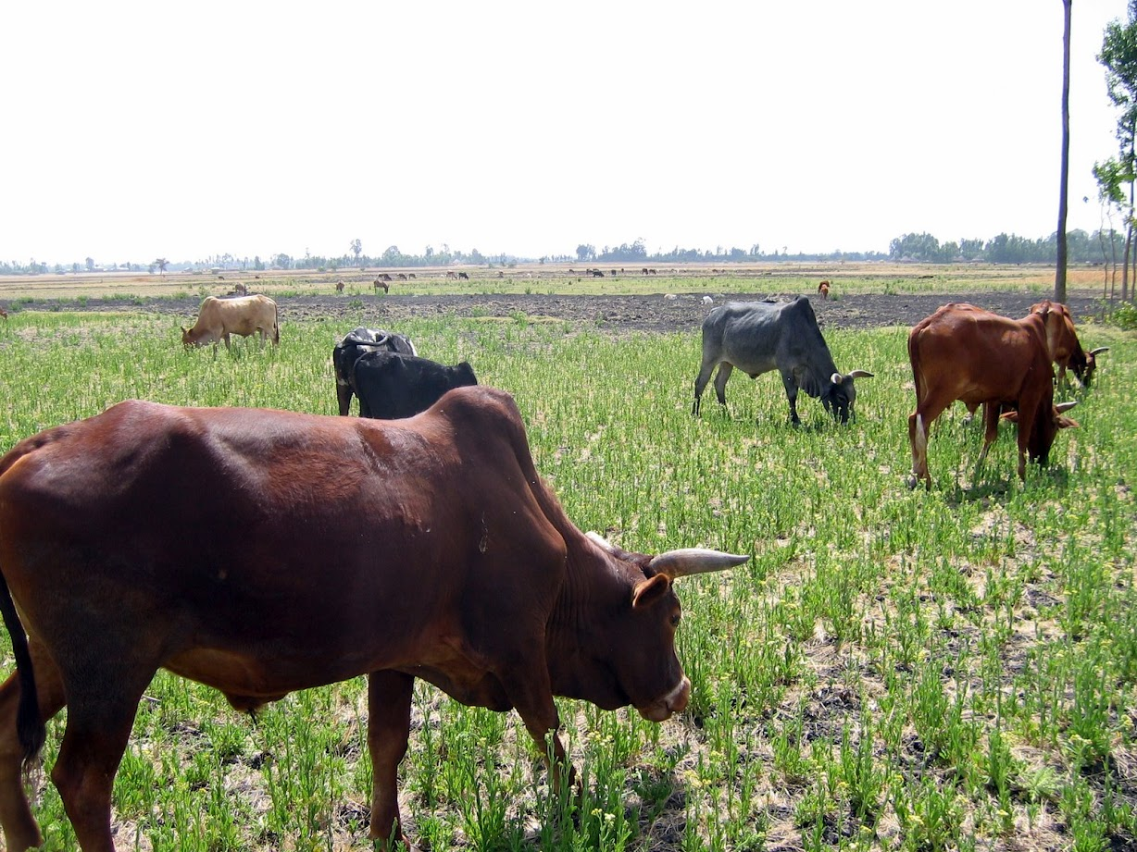

Slide 33
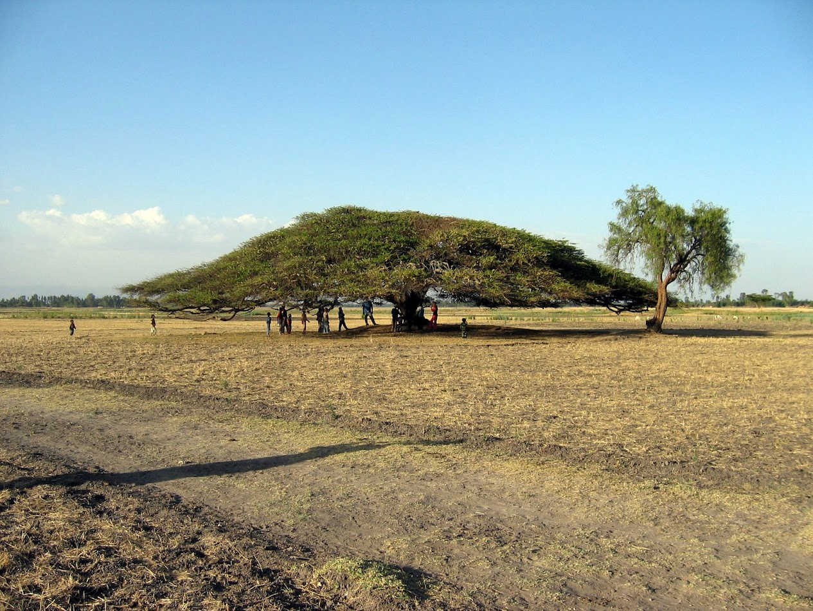

Slide 34
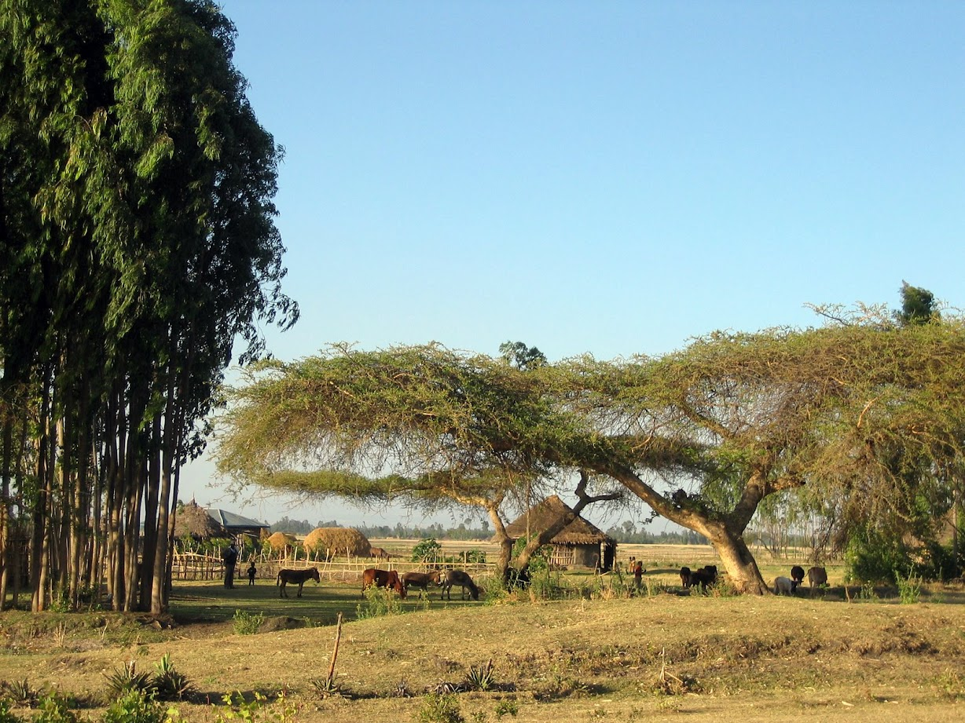

Slide 35
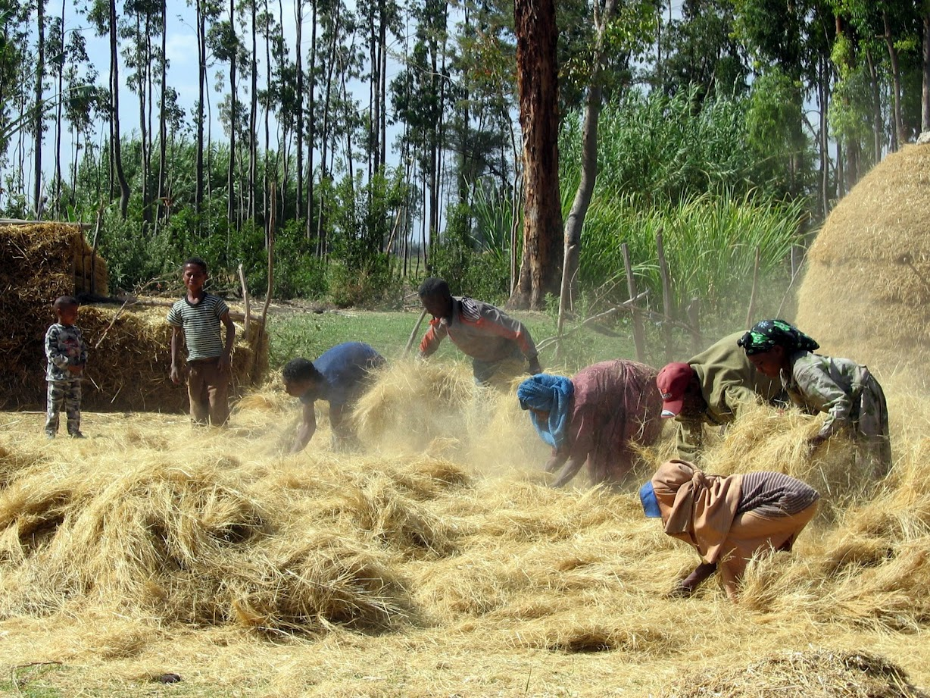

Slide 36
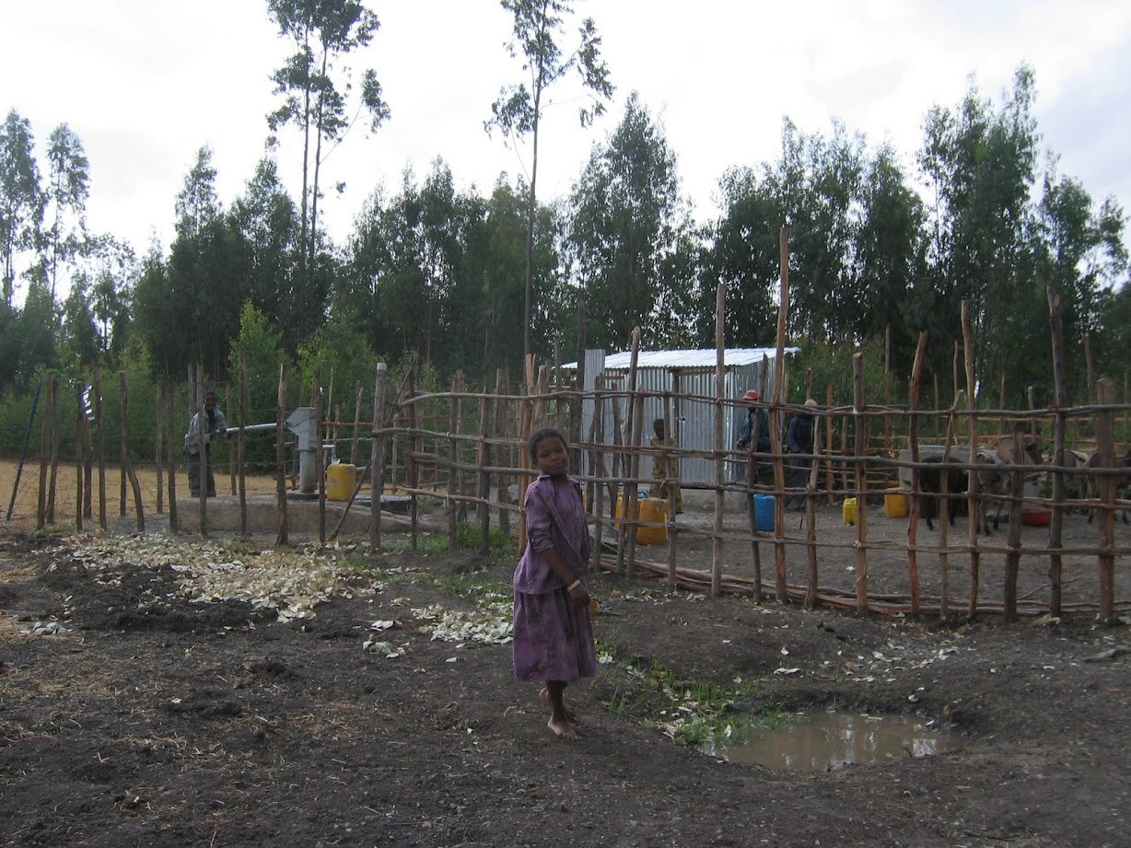

Slide 37
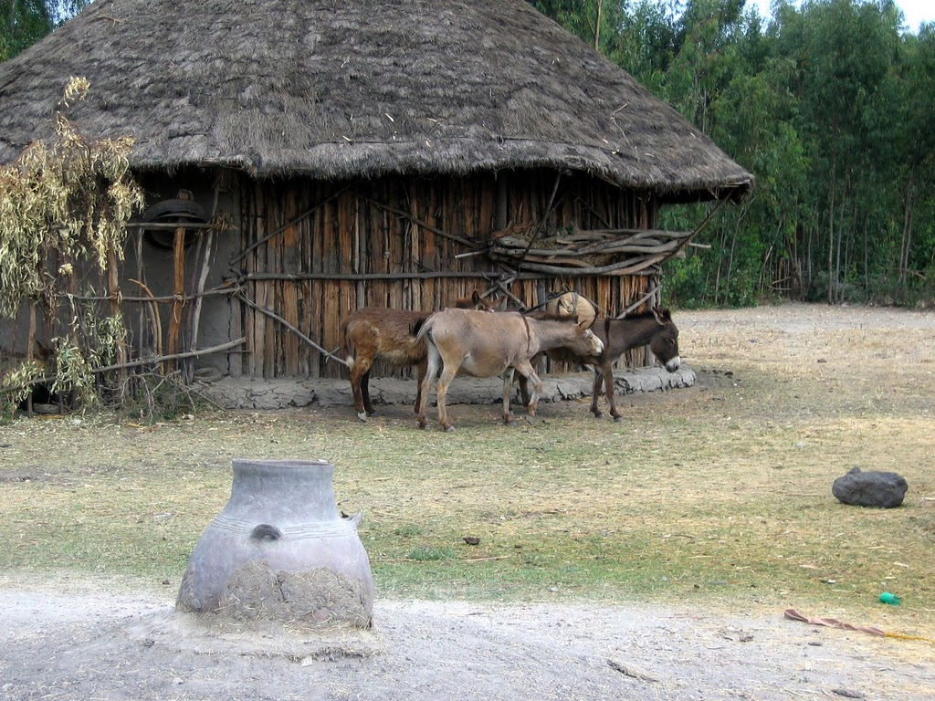

Slide 38
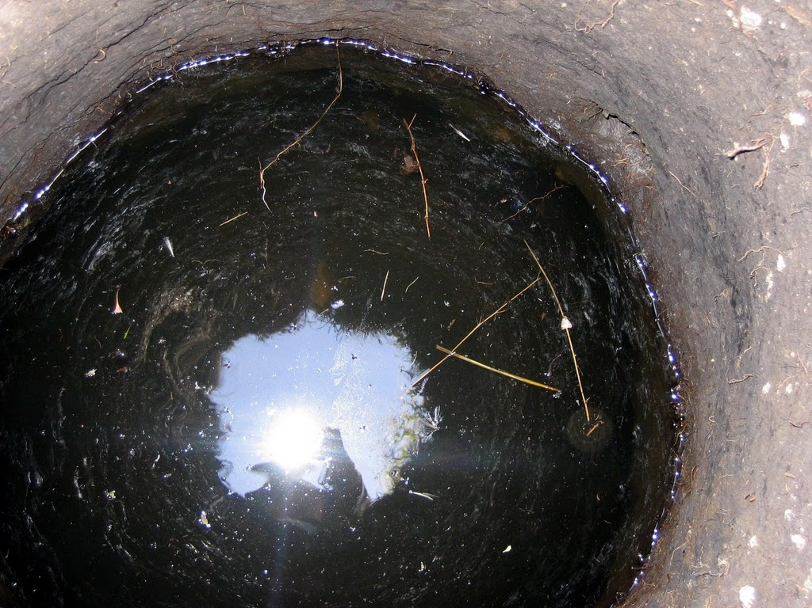

Slide 39
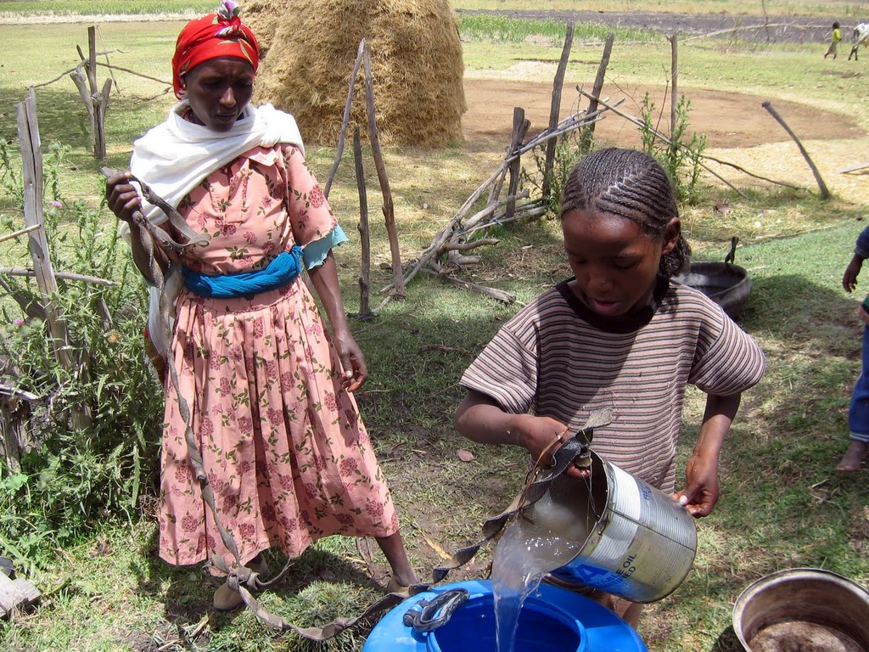

Slide 40
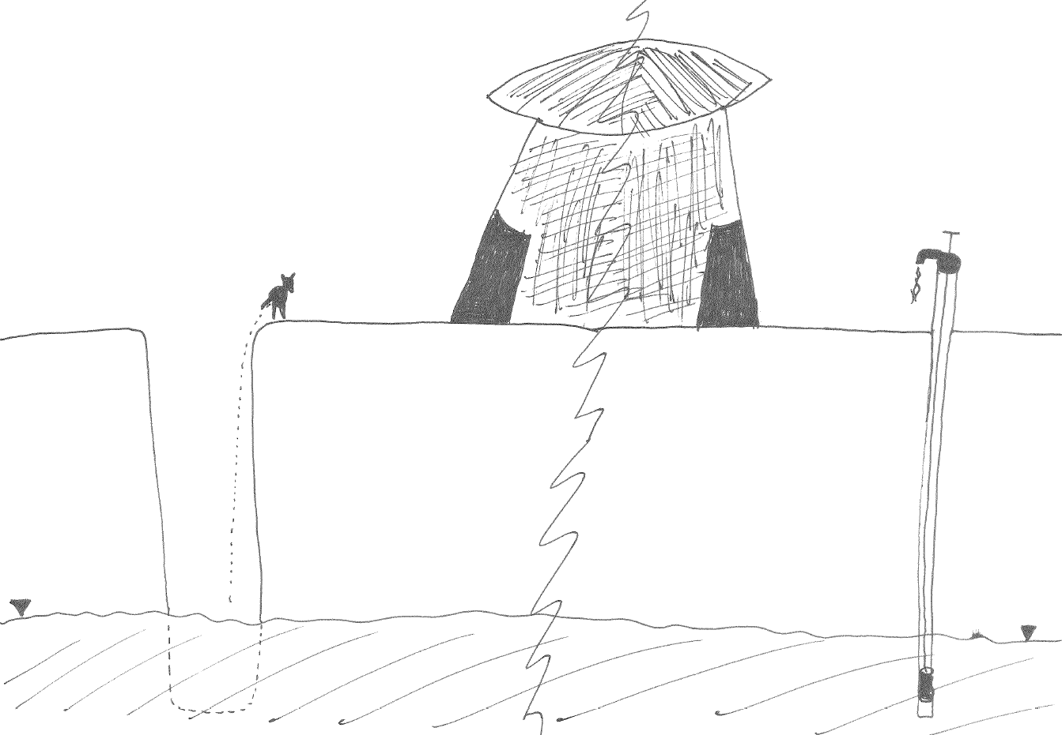

Slide 41
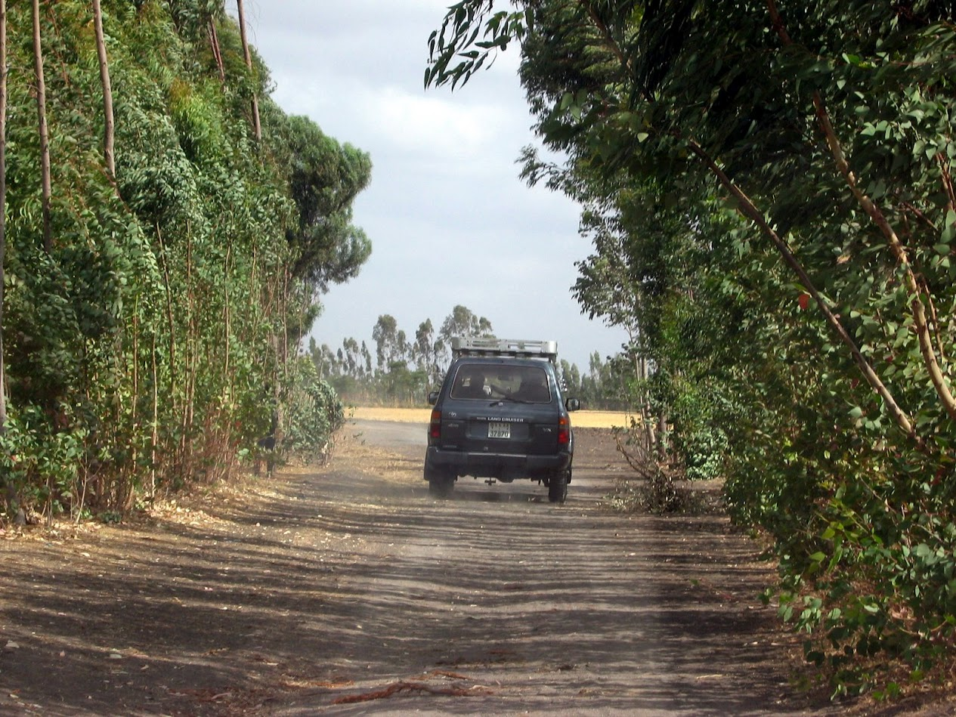

Slide 42
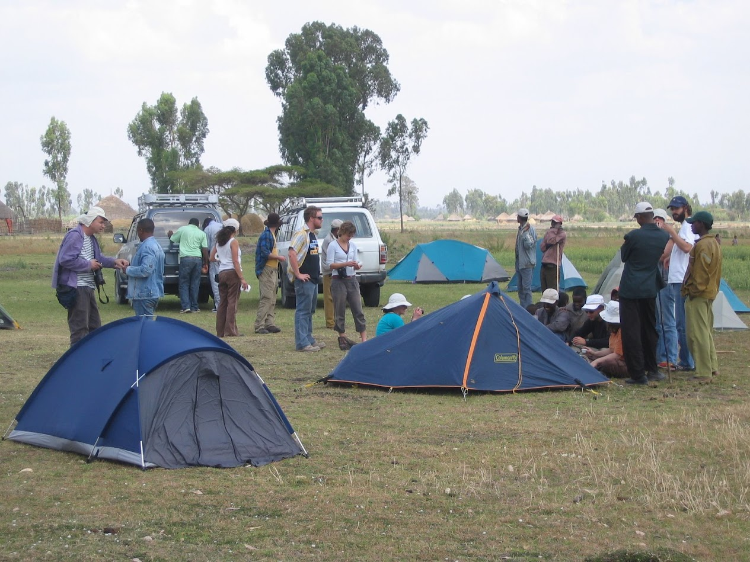

Slide 43


Slide 44


Slide 45


Slide 46











Slide 47


Slide 48


Slide 49


Slide 50


Slide 51


Slide 52


Slide 53


Slide 54


Slide 55


Slide 56


Slide 57


Slide 58


Slide 59
Canada Israel UK Bangladesh Ethiopia
9984670
22070 243610 144000 1104300
Area (km²)
&
population
Available water per
square km/year (m)
Available water per
Capita/year (m³)
Use of available
water (%)
Water use per capita
Per year (m³)
HDI
33M 7M 62M 147M 81M
8.5
0.29 0.08 0.6 0.11
86177
245 2375 8345 1503
102
1.58 8.81 2.92 4.556
1470
282 212 244
80.5
0.908 0.888 0.863
0.5
0.363

Slide 60

Bangladesh
~500km
~400km
Bangladesh

Slide 61


Slide 62

Bangladesh
Bangladesh is a mega-delta
The Ganges-Brahmaputra-Meghna rivers drain the Himalayas through Bangladesh into the Bay of Bengal
The country consists mainly of low and flat land formed by river sediments
Humid, warm tropical climate and is Monsoonal
Seasons:
Winter (December to February) is relatively cooler and drier.
Pre-Monsoon (March-June): Hot, high evaporation, heavy rainfall.
Monsoon (June to October): Hot and humid, with heavy torrential rainfalls. Post Monsoon (November) reduced rainfall, cooler nights.

Slide 63


Southwest Bangladesh
Salinity boundary 1997
Salinity boundary 1967

Slide 64


Slide 65


Slide 66


Slide 67


Slide 68


Slide 69



Slide 70


Slide 71


Slide 72


Slide 73


Slide 74
The problem
Increased incidence of pre-eclampsia, eclampsia and hypertension in pregnant women; elevated maternal mortality. Linked to increased intake of salt.
Salinity is penetrating further inland in rivers. At a point in the river salinity levels rise, and saline period lasts longer.
Groundwater is saline in places, but poorly understood.
Main source of drinking water is the rain fed ponds.
Scientific challenges:
1. What is driving the changes in salinity patterns in rivers (and groundwater)?
2. Are the ponds becoming salinized? If so, how? How can we prevent or mitigate pond salinization.

Slide 75
Pond salinization
Polder embankment
Sluice gate
Pond
River
Tidal range
House
Inlet/outlet channel
Pond
Pond
Tube well
Water table
Shallow aquifer
SOURCE
PATHWAY
RECEPTOR

Slide 76
Canada Israel UK Bangladesh Ethiopia
9984670
22070 243610 144000 1104300
Area (km²)
&
population
Available water per
square km/year (m)
Available water per
Capita/year (m³)
Use of available
water (%)
Water use per capita
Per year (m³)
HDI
33M 7M 62M 147M 81M
8.5
0.29 0.08 0.6 0.11
86177
245 2375 8345 1503
102
1.58 8.81 2.92 4.556
1470
282 212 244
80.5
0.908 0.888 0.863
0.5
0.363

Slide 77

UK:
~600km
~300km

Slide 78


Slide 79

Groundwater resources in UK
LONDON
(after the UK Groundwater Forum, 2004)

Slide 80


The English Chalk
Climate in SE England:
Ave. Precipitation ≈ 750 mm/y
Ave. Potential Evap. ≈ 480 mm/y

Slide 81


English Chalk: Landscape

Slide 82

English Chalk: Streams

Slide 83

English Chalk: Streams

Slide 84

Groundwater models
The UK Environment Agency has commissioned groundwater models of all the major UK aquifers;
Such “physically based” models are extremely resource intensive to develop, but in principle serve multiple purposes:
Flood risk and impact assessment
Drought risk
Groundwater pollution
Sustainable groundwater management
Take home message: UK water resources are relatively well monitored and modelled.
The BGS ZOOMQ3D groundwater model focusing on the Pang/Lambourn catchments

Slide 85
The 2012 Drought – March 2012 perspective
Most of SE and E England was in drought due to 2 dry winters
Past 6 months are driest since records began
Low groundwater recharge has led to drying of streams – EA has pumped water into streams and wetland to rescue fish, and is trying to help farmers locally
However, real impact of drought will hit in summer as plants transpire and dry soils out – severe drought is expected!
Government, EA, Water companies, working together to manage the situation
Important management decisions include:
Which farmers are allowed to fill irrigation reservoirs
Which rivers are priorities for environment and navigation.
Can water companies withdraw water below normally acceptable levels
What restrictions can water companies impose on consumers
Contingency plans being prepared for 2013. A hot dry summer would lead to significantly worse impacts.

Slide 86

The 2012 Drought – March 2012 perspective
Most of SE and E England is currently in drought due to 2 dry winters
EA 2012: http://publications.environment-agency.gov.uk/pdf/GEHO0312BWDT-E-E.pdf

Slide 87




The 2012 Drought – March 2012 perspective
6 months up to Feb 2012 are driest since records began
RAINFALL
RAINFALL
SOIL MOISTURE
1976
2011
2012
EA 2012: http://publications.environment-agency.gov.uk/pdf/GEHO0312BWDT-E-E.pdf

Slide 88

The 2012 Drought – March 2012 perspective
Stream flow is low now, but forecasts are worse
OBSERVATIONS
PREDICTIONS
EA 2012: http://publications.environment-agency.gov.uk/pdf/GEHO0312BWDT-E-E.pdf

Slide 89

The 2012 Drought – March 2012 perspective
Delayed response in streams is because they are fed by groundwater
Groundwater levels are declining:
OBSERVATIONS
PREDICTIONS
EA 2012: http://publications.environment-agency.gov.uk/pdf/GEHO0312BWDT-E-E.pdf

Slide 90
The 2012 Drought – March 2012 perspective
Low groundwater recharge has led to drying of streams – EA has pumped water into streams and wetland to rescue fish, and is trying to help farmers locally
However, real impact of drought will hit in summer as plants transpire and dry soils out – severe drought is expected!
Government, EA, Water companies, working together to manage the situation
Important management decisions include:
Which farmers are allowed to fill irrigation reservoirs
Which rivers are priorities for environment and navigation.
Can water companies withdraw water below normally acceptable levels
What restrictions can water companies impose on consumers
Contingency plans being prepared for 2013. A hot dry summer would lead to significantly worse impacts.
EA 2012: http://publications.environment-agency.gov.uk/pdf/GEHO0312BWDT-E-E.pdf

Slide 91



What about the Olympics!!!
New infrastructure was designed to reduce potable water usage significantly:
Rainwater harvesting from roofs, car parks and other hardstandings.
A non-potable supply network across the Olympic Park has been installed to supply water for events, irrigation and cleaning. This non potable supply network is planned to be supplied by a blackwater re-use plant, taking water from a Thames Water sewer main.
Water efficient fixtures and fittings (e.g. low flow taps, waterless urinals).
Swimming pool backwash recycling.
However, the enhanced water demand is an additional consideration for planning
Rowing and canoe venues may be relocated.
Specific boreholes and streams have been identified as back up supplies

Slide 92


The 2012 Drought – what actually happened?
“The wettest drought in history”
The driest spring for over a century gave way this year to the wettest April to June on record (230 yrs)¹
20 million people had been issued with a hosepipe ban and 200 drought related environmental incidents and major roads cracking in the dry conditions
Then “the heavens opened, river levels tripled and reservoirs went from their lowest ever levels to full or exceptionally high. Flooding hit almost every region of England and Wales from May to July”¹
REALITY
REALITY
1. http://www.ceh.ac.uk/news/news_archive/drought-flood-transformation-uk_2012_54.html

Slide 93
Summary:
Water is one of the most important resources.
Many people are dying due to water related problems.
Different challenges require different solutions.
Sometimes similar challenges require different solutions due to cultural, economical and technological differences.
There is a lot of water on Earth.
The right management and priorities could save many lives.
We are lucky!!
As scientists we shouldn't forget the real problems of our world; which we have the privilege to contribute something for the solution.

